Slide 1
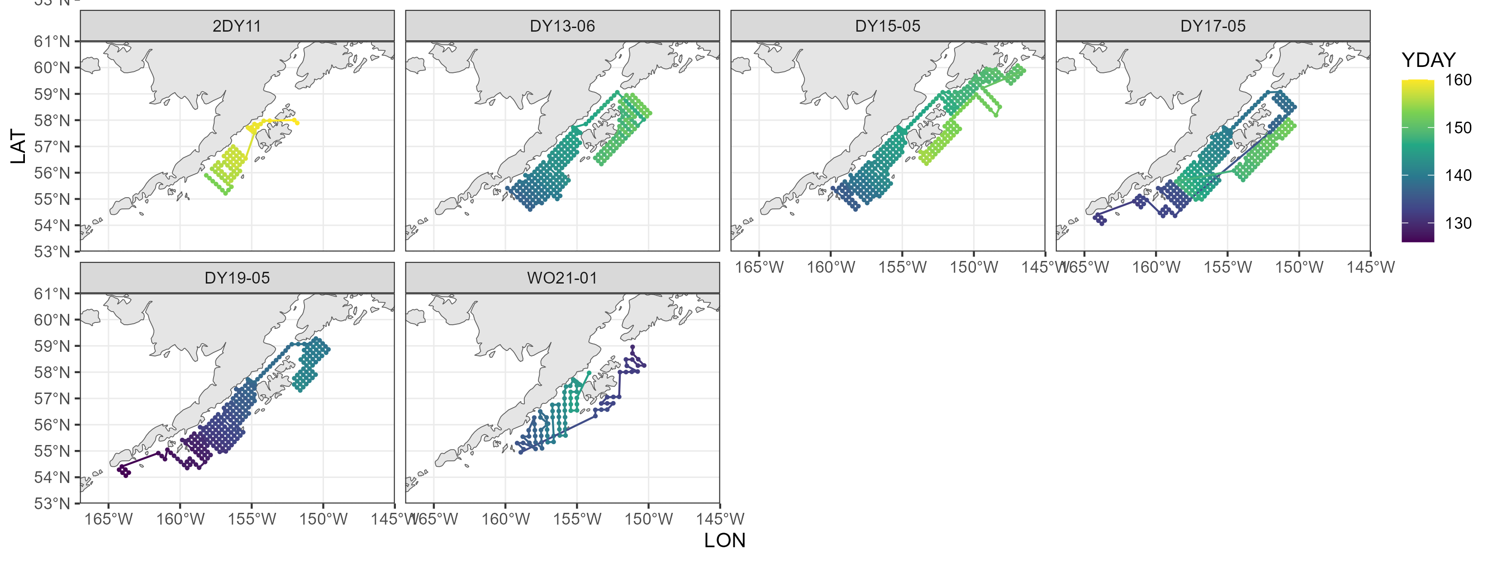
Spring Larval 2025 Survey Station Selection
Focus on 2013 – 2019: Note that all station sampling went SW to NE. I’m reasonably sure that the surveys started in DH. Therefore, even if we started in Kodiak, I’m leaning on steaming to a starting point toward the Shumagins

Slide 2
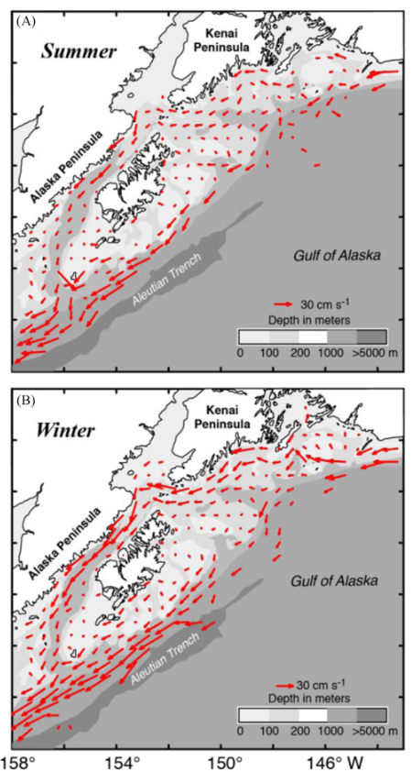
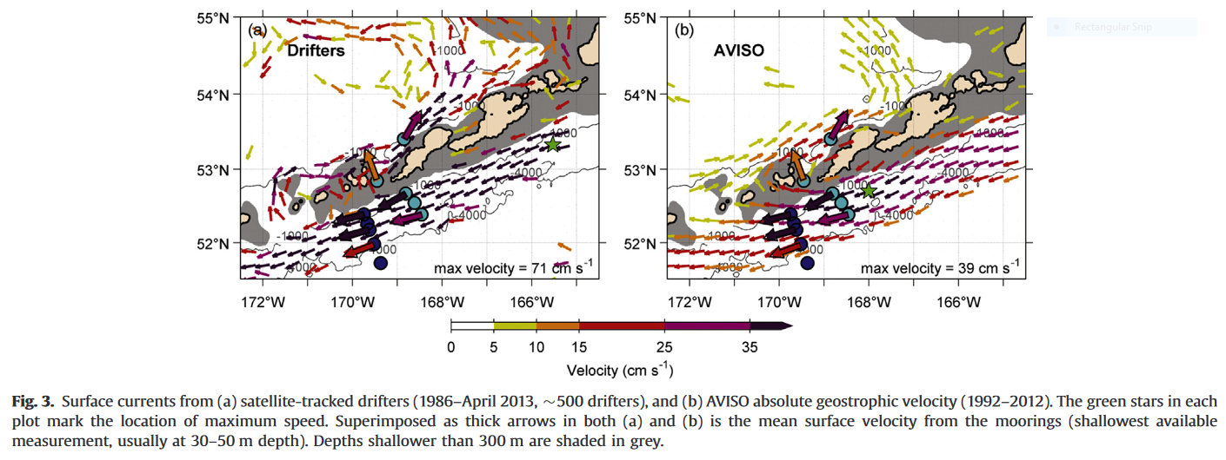
Spring Larval 2025 Survey Station Selection
Regarding currents, Emily pointed me to these two plots (left is Stabeno et al. (2016), right is Stabeno & Hristova (2016)
Take away: currents move SW along the Aleutian peninsula (note the 18 year time period in the figure caption above)
If we begin in Kodiak and use the strategy utilized by the 2024 Spring Larval survey (every other survey line away, then fill in-between those lines on the way back), it will be unprecedented in our time series.

Slide 3
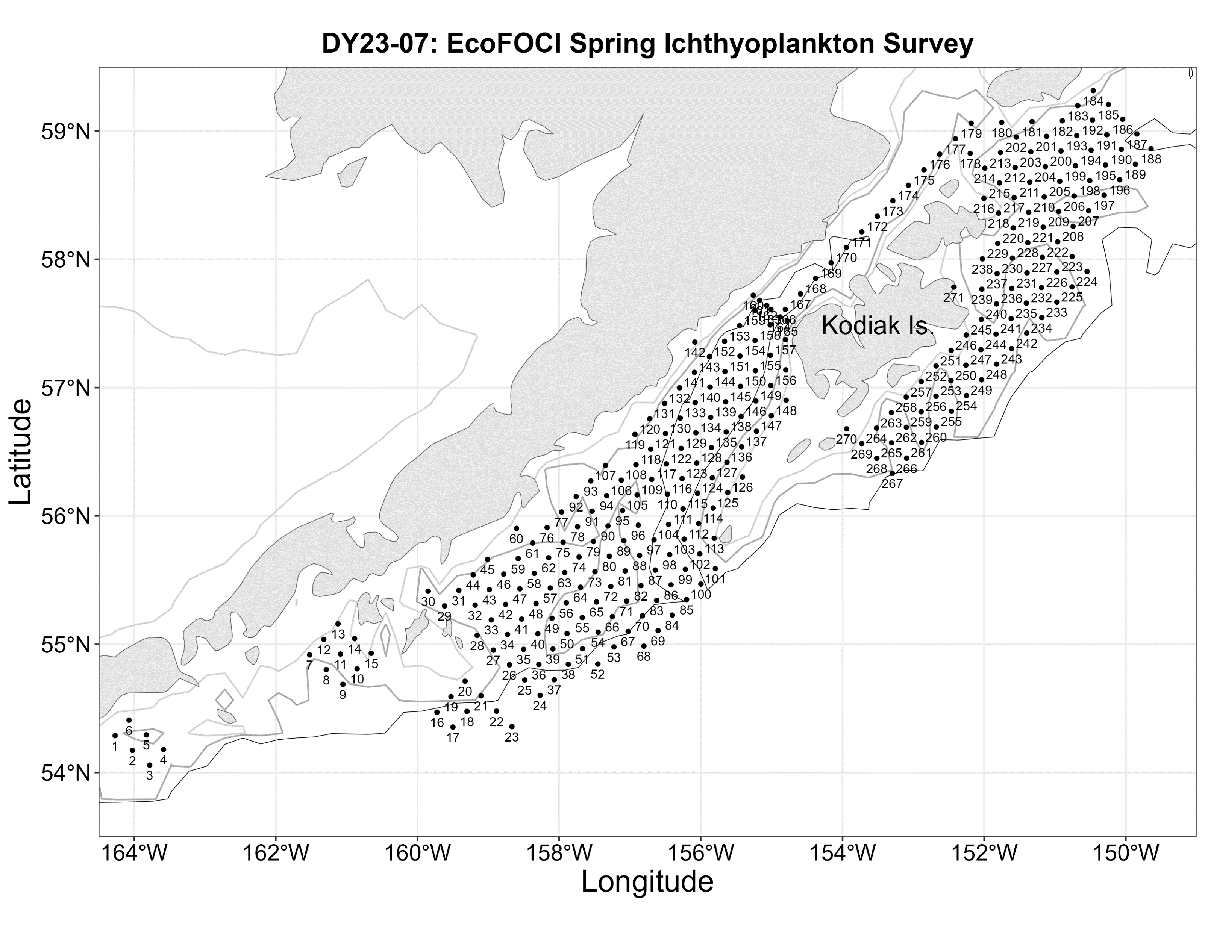
Spring Larval 2025 Survey Station Selection
Map taken from 2019 Spr Larval Project Instructions: 272 Stations
Mean Stations sampled per day (2013 – 2019 surveys) ~ 13 sta/day
2025 Spr Larval Scheudle: 5/15 – 6/2 = 19 days
Subtract ~ 2 days for transit time (starting from DH or Kodiak + 1 weather day): 17*13sta/day ~ 221 stations
Next: Prioritization!

Slide 4
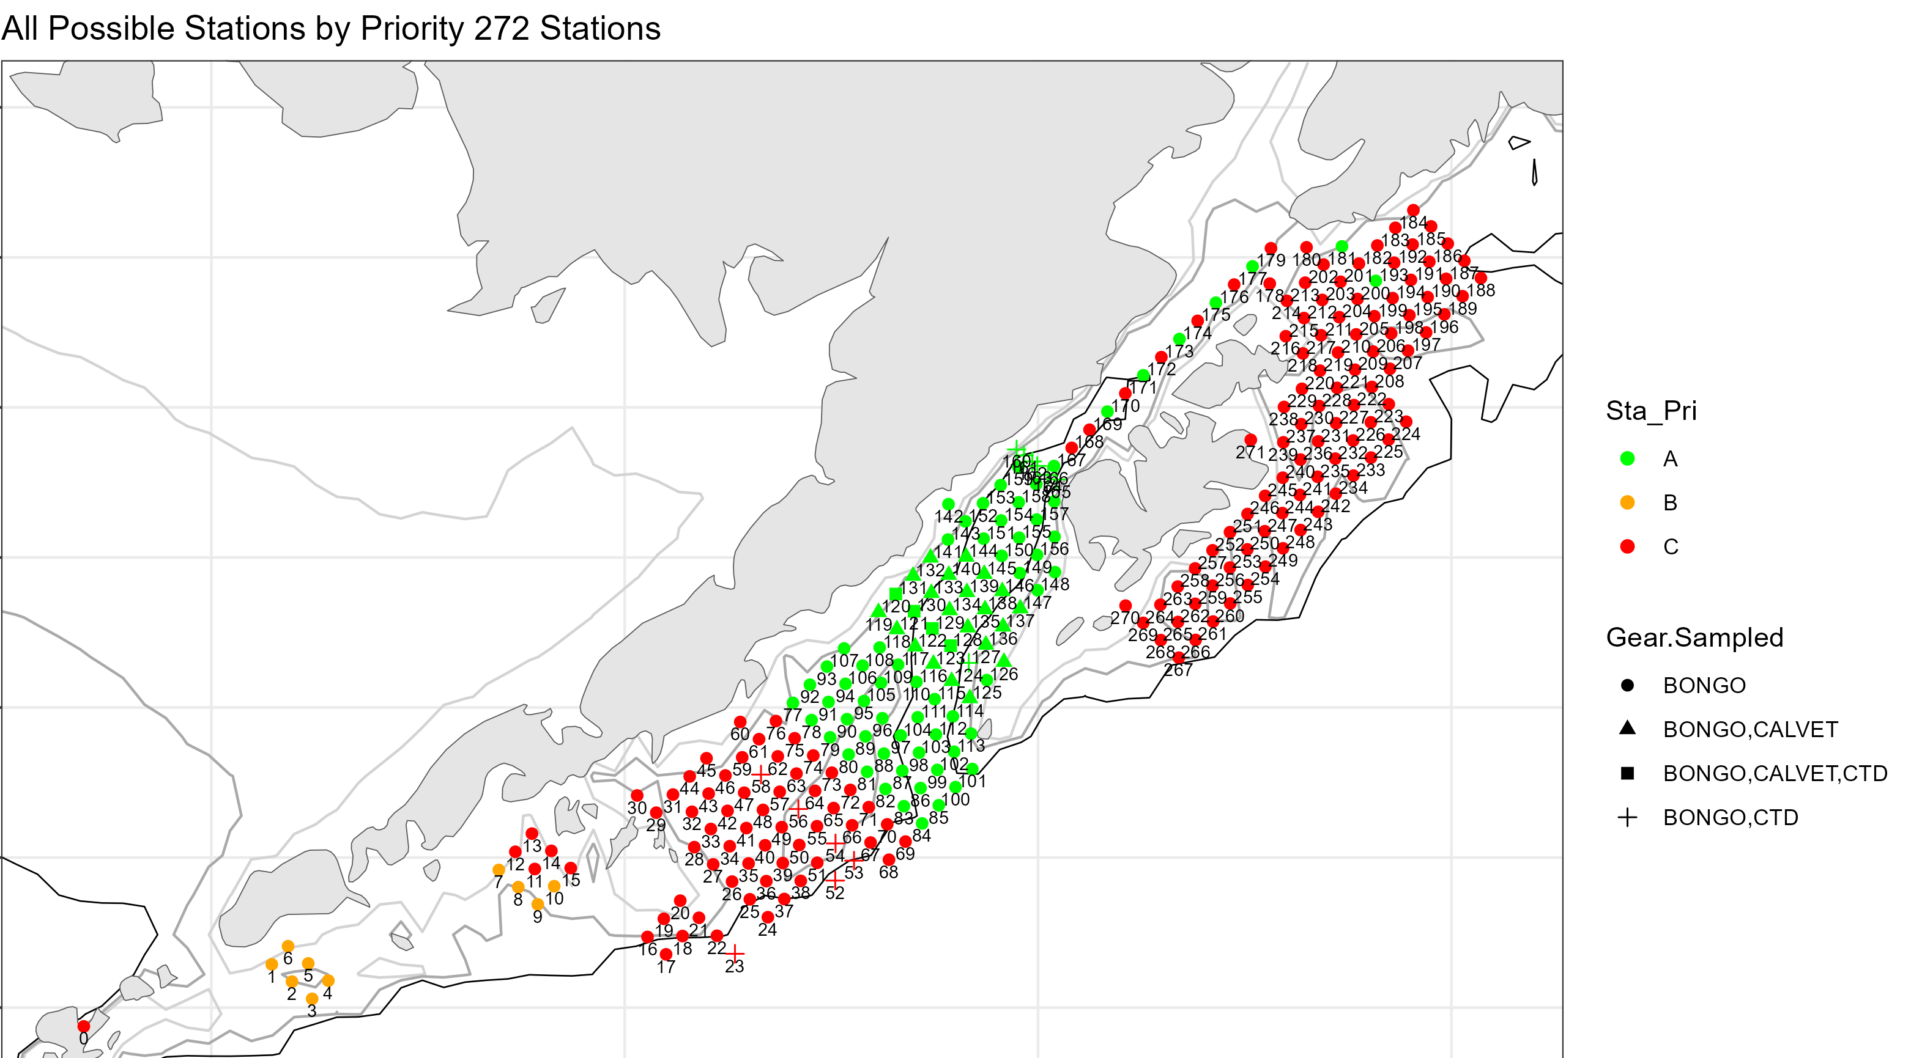
Spring Larval 2025 Survey Station Selection
My Opinion: Start at station 24 (circled), work north to Shelikof Str, then around Kodiak.
Rationale for omitting SW of Shumagins: not frequently sampled enough historically

Slide 5
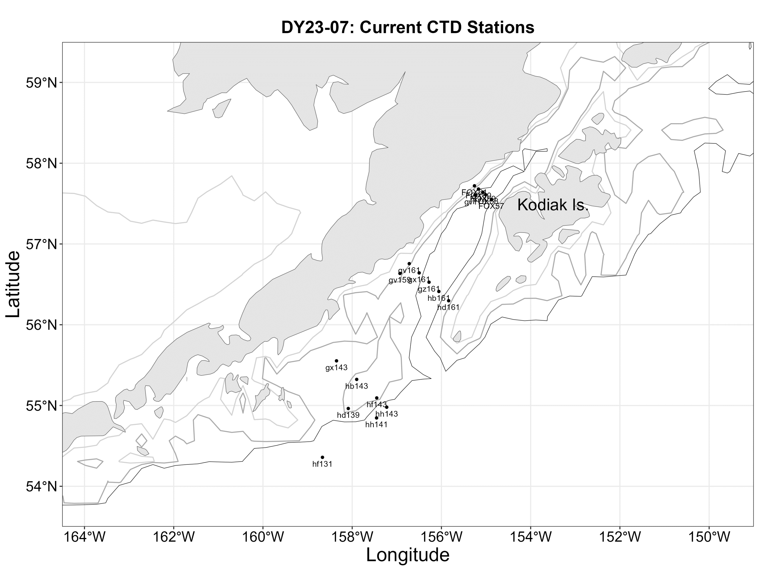
Spring Larval 2025 Survey Station Selection

